Slide 1
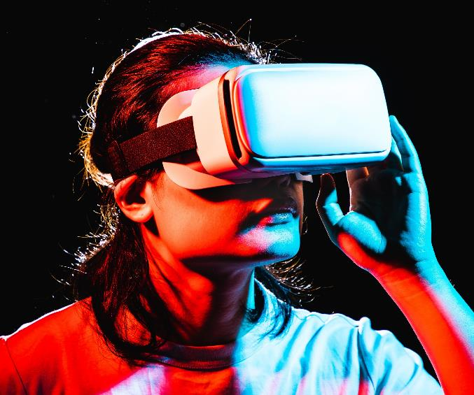
Understanding Data Centres and Virtualization
An in-depth exploration of data centers, their components, and the role of virtualization in modern IT infrastructure.

Slide 2

Overview of Data Centres & Virtualization
What is a Data Centre
What is Virtualization
Data centres are centralized locations that store computer systems and associated components, such as telecommunications and storage systems, crucial for the management of data.
Virtualization is a technology that allows for the creation of a virtual version of physical devices, enabling better resource utilization and flexibility within IT environments.

Slide 3
Types of Data Centres
Enterprise Data Centres
Colocation Data Centres
Cloud Data Centres
Edge Data Centres
Private facilities specifically owned and operated by individual companies to securely manage their data and IT operations.
Shared facilities where multiple businesses can rent space, allowing them to share infrastructure and reduce costs.
Virtualized environments providing scalable resources hosted by third-party providers, allowing on-demand access to computing power and storage.
Distributed data centres located close to end-users to minimize latency and enhance the performance of applications and services.

Slide 4
Types of Virtualization
Server Virtualization
Storage Virtualization
NETWORK Virtualization
DESKTOP Virtualization
Dividing a physical server into multiple virtual servers, each running its own operating system and applications
Creating multiple virtual networks on a single physical network, enabling different networks to operate independently
Pooling multiple storage devices into a single virtual storage resource, making management and allocation easier
Running desktop environments on central servers and delivering them to end users’ devices remotely.

Slide 5
Types of Virtualization
APPLICATION Virtualization
Running applications in isolated virtual environments, making them accessible without being installed on end-user devices.

Slide 6

BENEFITS of Data Centres
Data Security and Backup
Efficient Resource Management
Supports Digital Transformation
High Availability and Reliability

Slide 7
BENEFITS of Virtualization
Cost Savings
Scalability and Flexibility
Improved Disaster Recovery
Energy Efficiency

Slide 8
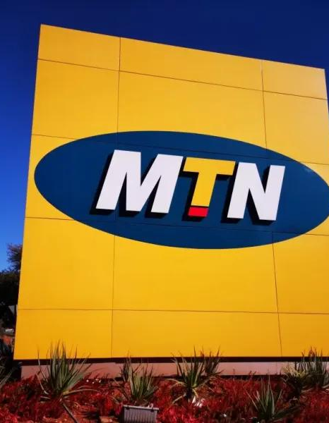
Companies in Ghana Using Data Centres(MTN)
MTN provides cloud storage, colocation, and data hosting services to businesses in Ghana. For example, MTN’s data centre supports its Mobile Money (MoMo) platform,
USE CASE
Benefit
Enhanced reliability, scalability, and security for telecom services and enterprise solutions, ensuring that mobile services and financial transactions are consistently available and secure.

Slide 9
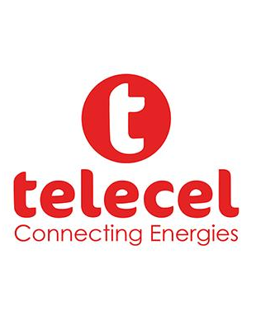
Companies in Ghana Using Data Centres(TELECEL)
TELECEL’S data centre supports their Vodafone Business Solutions, which provide cloud storage, disaster recovery, and data management services for clients in various sectors like banking, retail, and education
USE CASE
Improved business continuity, data security, and efficient data management for clients, ensuring they can operate smoothly without interruptions
Benefit

Slide 10
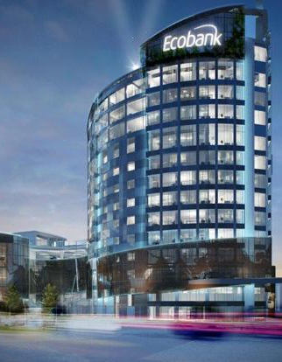
Companies in Ghana Using Virtualization (Ecobank Ghana)
Ecobank uses server virtualization to run multiple banking applications on fewer physical servers. This supports operations such as online banking, ATM services, and mobile banking.
Use Case
Increased efficiency, reduced hardware costs, and improved disaster recovery. Virtualization helps Ecobank scale their IT infrastructure without investing in additional physical servers.
Benefit

Slide 11
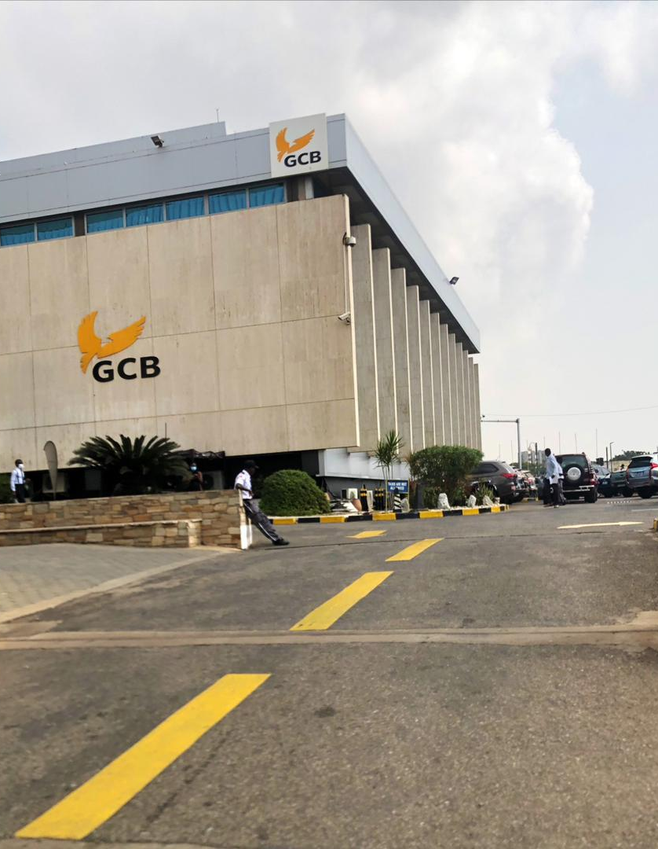
Companies in Ghana Using Virtualization (Ghana Commercial Bank (GCB))
GCB utilizes desktop and server virtualization for their branch operations and customer service applications. Virtual machines host core banking systems, allowing tellers to access centralized applications efficiently
Use Case
Benefit
Scalable IT infrastructure to support growing operations, secure customer data, and ensure quick recovery in case of hardware failures

Slide 12

Challenges of Implementing Data Centres & Virtualization
High Initial Setup Costs
Need for Skilled IT Personnel
Data Security Concerns
Hardware and Software Investment: While virtualization reduces costs in the long run, the initial setup of servers, software licenses, and infrastructure can be expensive. Companies like small to medium-sized enterprises (SMEs) may find the upfront investment challenging.
Training Requirements: Managing virtualized environments requires specialized skills. Companies may need to invest in training programs or hire experienced IT professionals, which can be costly
Risk of Breaches: Virtual environments are susceptible to cyberattacks if not properly secured. For example, a misconfiguration in a virtual network can expose sensitive data
Downtime During Migration
Service Disruption: Migrating from physical to virtual environments can cause temporary downtime. For example, banks or telecom companies may face brief interruptions during the transition, impacting customer services

Slide 13
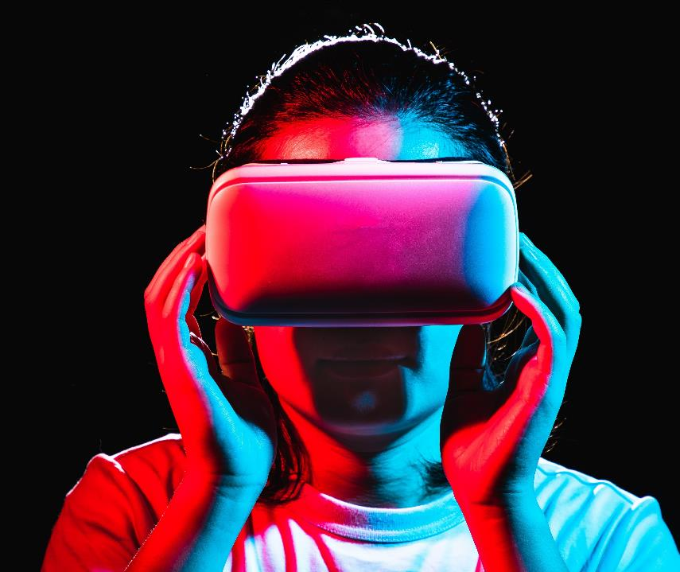
Thank you

